Slide 1
Testing

Slide 2
2 types testing in Angular
Unit testing - testing small, isolated pieces of code
Functional testing - e2e testing

Slide 3
Unit testing

Slide 4
Place your tests in a .spec.ts file
Put unit test spec files in the same folder as the application source code files that you test
Test your overall test coverage with:
ng test --no-watch --code-coverage

Slide 5
Jasmine
Jasmine-core is the framework we are going to use to create our tests.
Jasmine is a behaviour-driven development framework for testing.
Jasmine also provides mocking.
Notes:
describe, beforeEach, afterEach and it

Slide 6
Karma
Karma is a test runner. It uses a configuration file in order to set the startup file, the reporters, the testing framework, the browser among other things.
Karma opens up the browser in order to run the tests.

Slide 7
Testbed and async ?
TestBed is a mock environment to run Angular2 component tests without the browser.
TestBed and async makes testing asynchronous code, components, directives, or services easier.
Testbed makes use of Jasmine test framework

Slide 8
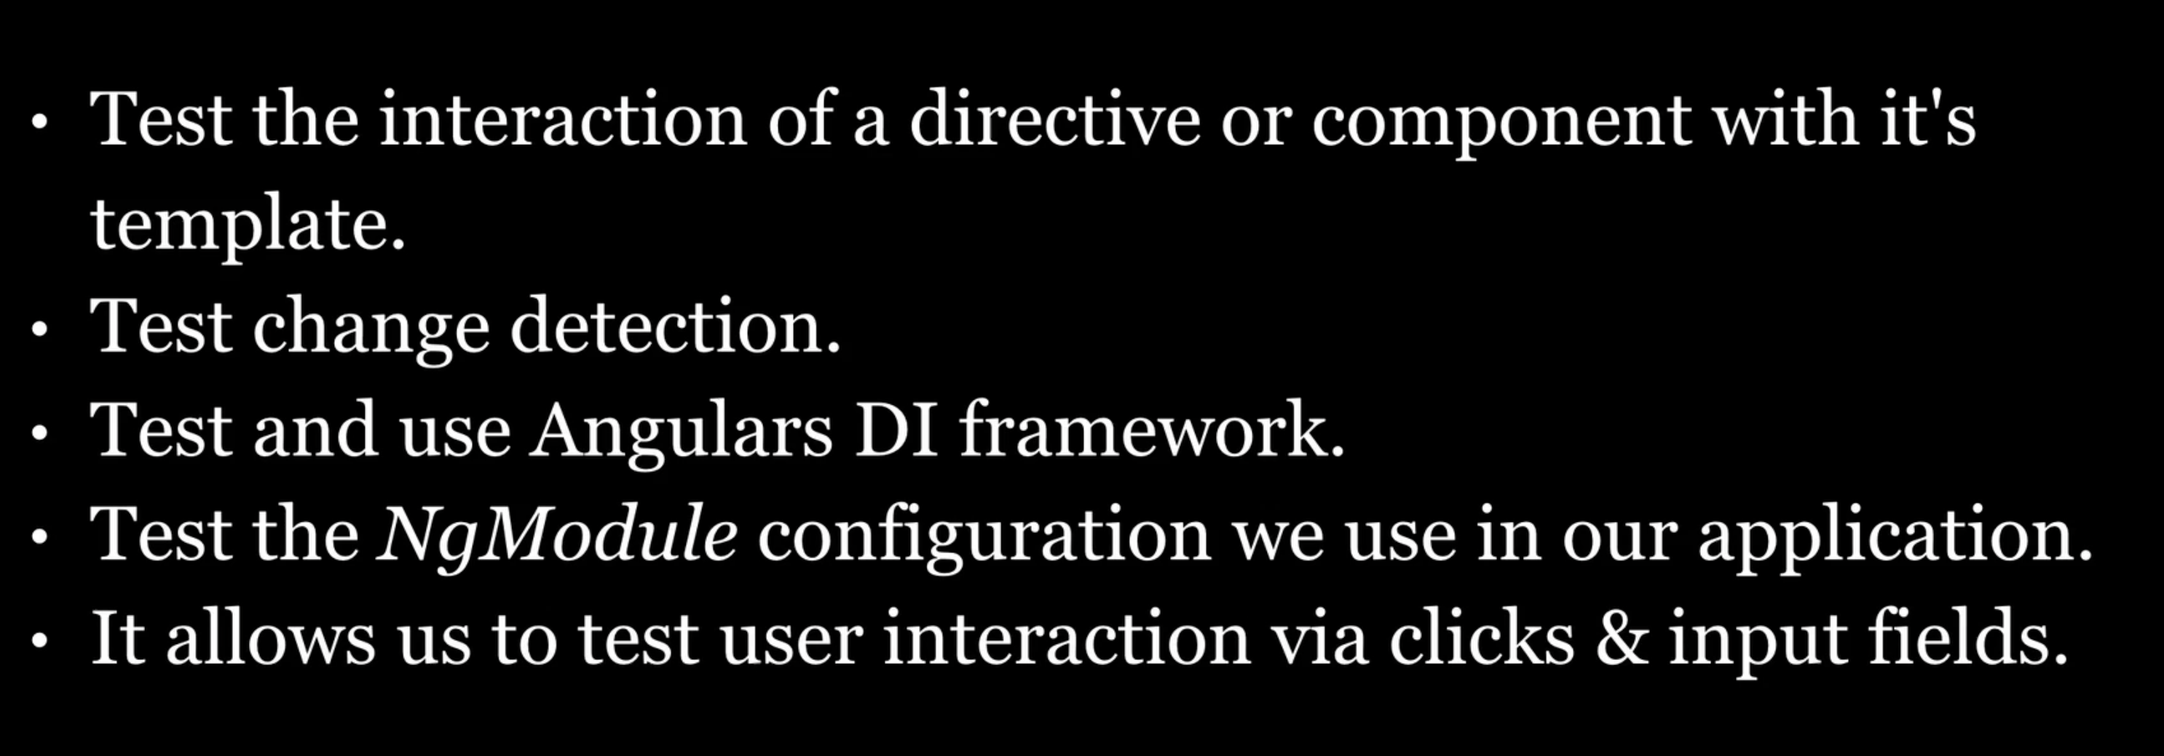
Why using Testbed in Angular?

Slide 9
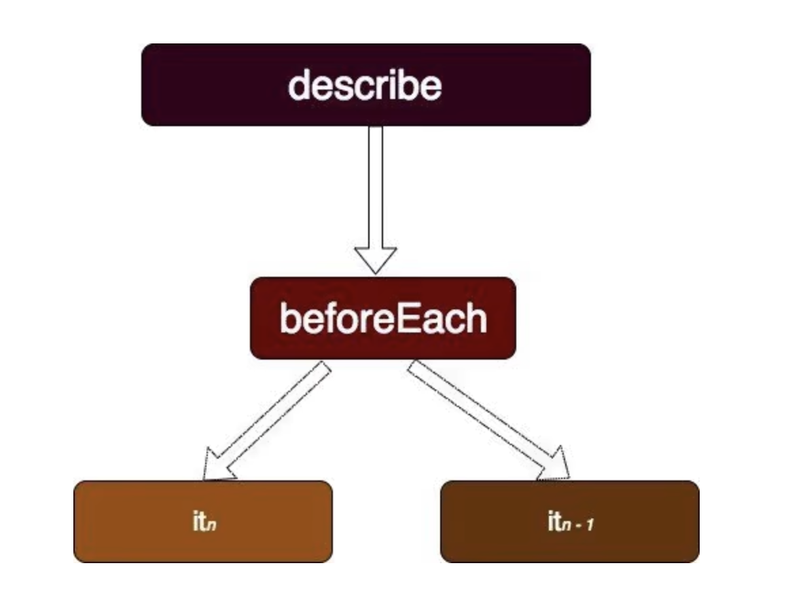
How to write a unit tests?
Notes:
The describe container contains different blocks (it, beforeEach, xit, etc.). beforeEach runs before any other block. Other blocks do not depend on each other to run.

Slide 10
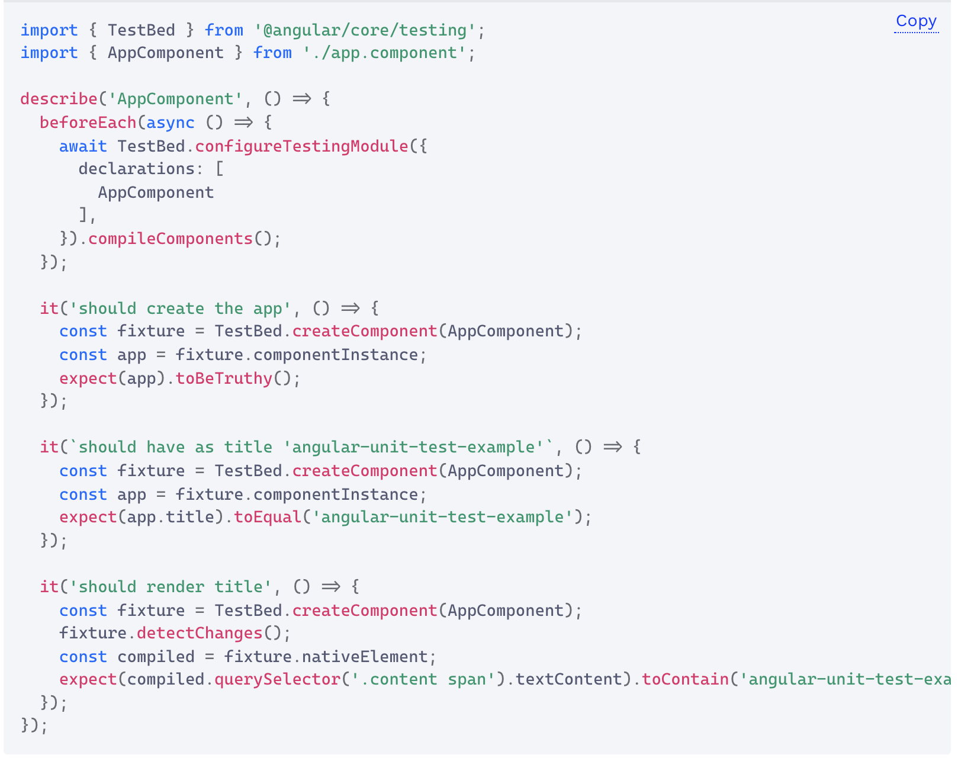

Slide 11
Use Jasmine in Testbed
First, a few things that are important to know about Jasmine:
The describe-blocks define a test suite.
And each it-block is for an individual test.
beforeEach runs before each test and is used for the setup part of a test.
afterEach runs after each test and is used for the teardown part of a test.
You can also use beforeAll and afterAll, and these run once before or after all tests.
You test an assertion in Jasmine with expect and using a matcher like: toBeDefined, toBeTruthy, toContain, toEqual, toThrow, toBeNull,
… For example: expect(myValue).toBeGreaterThan(3);
You can do negative assertion with not: expect(myValue).not.toBeGreaterThan(3);
You can also define custom matchers.

Slide 12
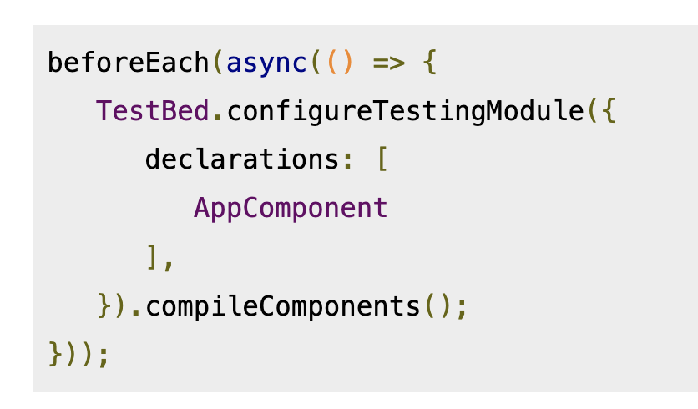
beforeEach in Testbed ?
This is the only block that runs before any other test.
You need to configure the TestBed before each test, adding any components, modules and services you need for the test.
It's just like configuring a regular @NgModule from scratch, but you just add what you need.
The compileComponents object is called to compile your component’s resources like the template, styles

Slide 13
component fixture
You can create a component fixture with TestBed.createComponent.
Fixtures have access to a debugElement, which will give you access to the internals of the component fixture.

Slide 14
Change detection in unit tests
Change detection isn’t done automatically, so you’ll call detectChanges on a fixture to tell Angular to run change detection.

Slide 15
How to start the tests?
ng test

Slide 16
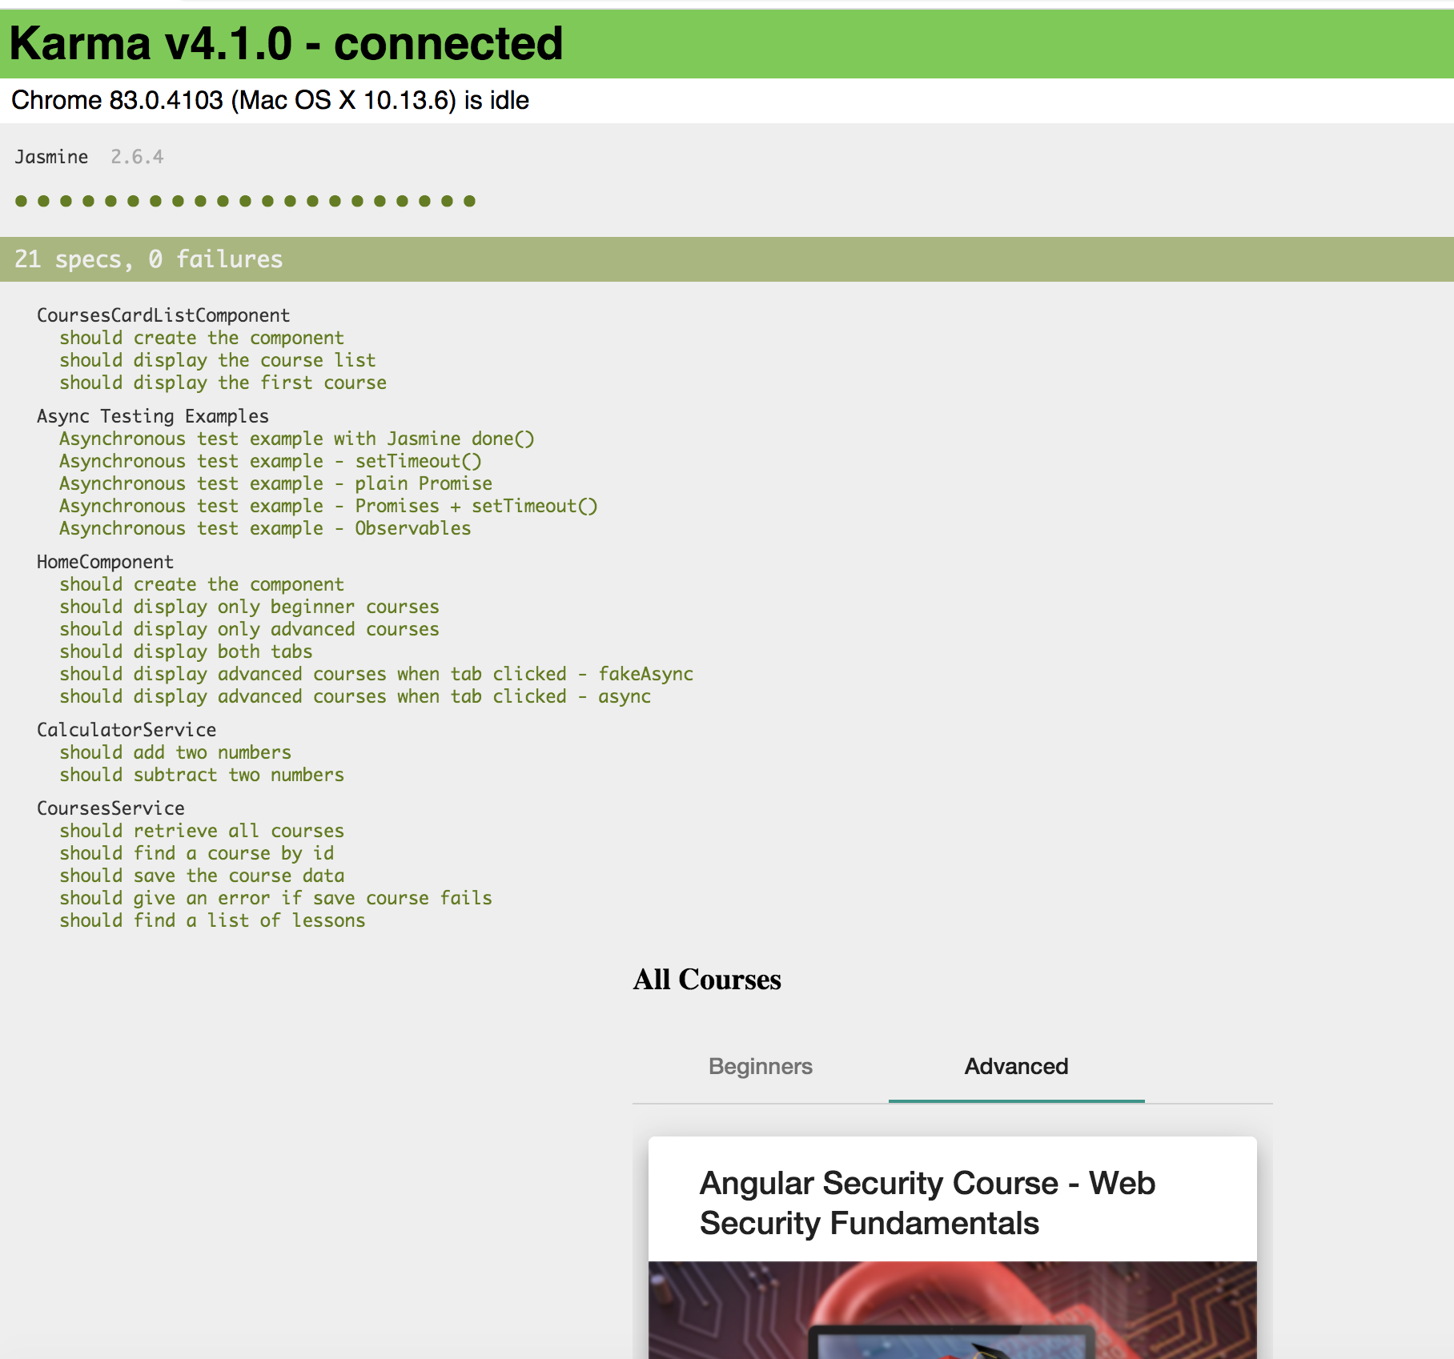

Slide 17
Angular Testbed
Testbed uses: Karma/Jasmine
https://codecraft.tv/courses/angular/unit-testing/mocks-and-spies/
https://www.digitalocean.com/community/tutorials/angular-introduction-unit-testing
https://blog.logrocket.com/angular-unit-testing-tutorial-examples/

Slide 18
G07- Unit testing
Frontend:
npm install
npm start
Backend
npm run server
Start Karma tests:
ng test

Slide 19
Cypress end-to-end testing

Slide 20
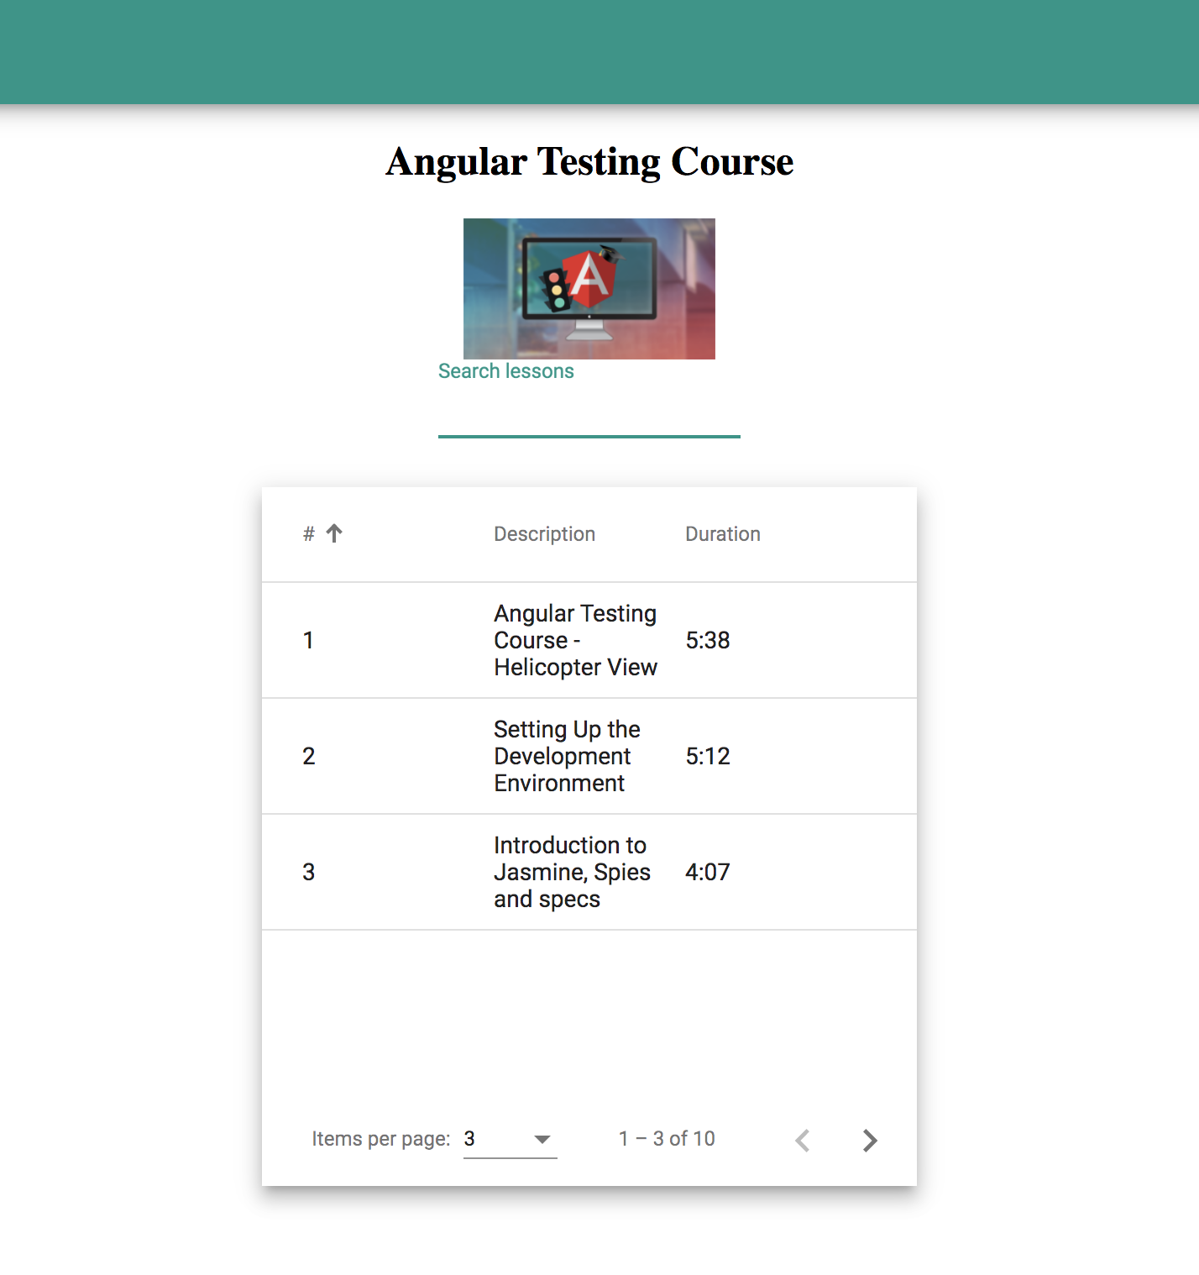
G07- Cypress testing

Slide 21
Cypress e2e testing
Running Cypress Start Cypress via: npm run cypress:open
Running tests Click on the `feature`-file you want to test
Best practices Follow this site to set up the tests:
https://docs.cypress.io/guides/references/best-practices

